Slide 1
GPS Trail
Group 1: Fade Abdeljaber, Chris Lenell, Deonvell Shed, Luke Wittenkeller

Slide 2
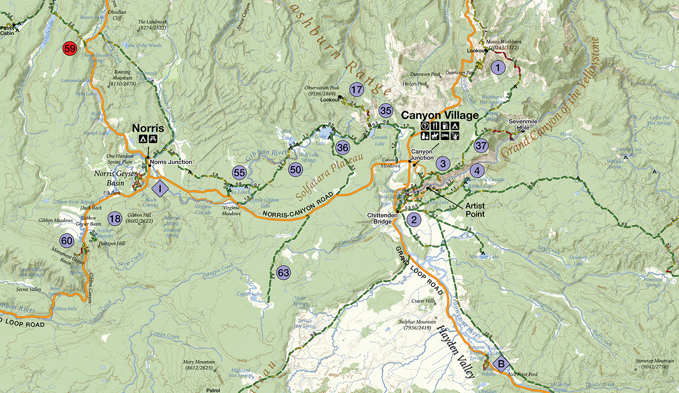
Idea
Smartphone app to be used inside national parks
GPS map of the trails in National Parks and forests
User inputs what landmarks they want to see, and app finds a path

Slide 3
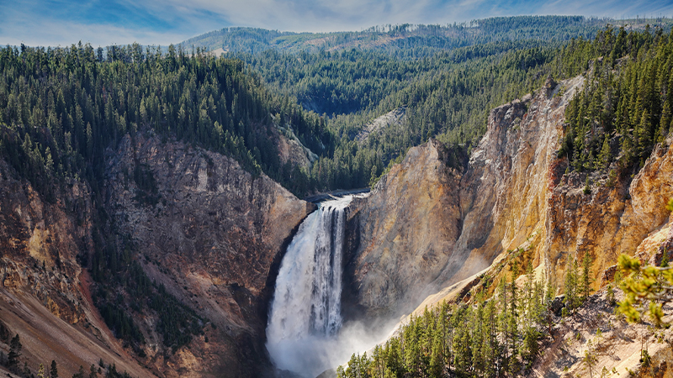
Project Purpose
Make navigation of National Parks easier and faster
Bring in more visitors to the parks
Promote local businesses

Slide 4
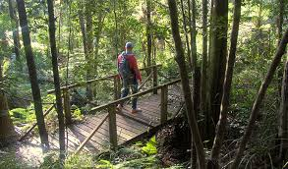

Scope
Entertainment and guidance of visitors through national parks
No more wasting time searching for best paths
Multiple types of users

Slide 5

Scenarios
Find the Best Route
Edit an Path
Edit Prohibited Areas
Recommended Areas
Path Traffic

Slide 6

Stakeholders & Users
National Park Service
National Park workers are key users
Will provide feedback during development of app
Maintenance users required to ensure paths are up to date and safe
Intended for users over 16

Slide 7

Constraints
Mobile device app running IOS or Android
Unstable internet connection
Heavy reliance on Google’s API
Budget constraints due to the cost of making calls to Google’s API

Slide 8
Facts and Assumptions
The time when national parks receive the most visitors is during the summer.
The application will use Google’s API in order to generate a path for the user.
The maps of the national parks will also be downloaded during the installation of the application.
The users device running the application will be either an iPhone running IOS or an Android running any android operating system that allows .apk files to be installed

